Slide 1
HPV and cancer in women
Malcolm Padwick MD FRCOG
Powerpoint download
Gynaecology.me.uk

Slide 2
Disease and HPV
HPVs are group of 150 related viruses
40 can be spread by direct skin to skin contact at vaginal, anal or oral sex.
HPV is the most common sexually transmitted disease
More than 50% of sexually active people will be infected during their lifetime
42.5% of women have genital infection of HPV
7% of adults have oral HPV infection

Slide 3
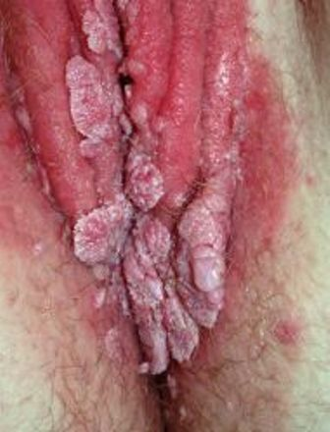
Types of HPV
Low risk – do not cause cancer but do cause warts on vulva, perineum and anus. Types 6, 11 = 90% of cases

Slide 4
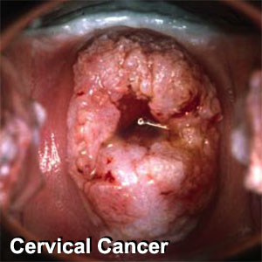
Types of HPV
High risk HPV associated with cancer. A dozen high risk types but 16, 18 cause > 70% of cancers

Slide 5
HPV and cancer
High risk HPV accounts for 5 % of all cancers world wide [1]
Most infections are asymptomatic and disappear in 1 to 2 years
They do cause cytological atypia whilst active but this resolves as the infection disappears
Some high risk infections persist and cytological atypia can mutate to cancer
1. International Journal of Cancer 2006; 118(12):3030–3044

Slide 6
Which cancers?
All cervical cancer - 16 and 18 cause 70%
Anal cancer with 85% caused by type 16
Vulval and vaginal cancer – 16 and 18
Oropharyngeal cancer with > 50% linked to type 16 (with in 20 years this cancer will be x4 commoner than cervical cancer)(mostly white males 40-50 yrs)

Slide 7
Other risk factors
Smoking
Reduced immunity
Multiparity
Long term oral contraception
Poor oral hygiene
Chronic inflammation

Slide 8
HPV prevention
Avoid skin to skin oral, anal or genital contact with infected / potentially infected person
Sexually active – mutually monogamous relationship
Consistent use of condoms
Vaccines CERVIRAX vs 16, 18
Vaccines GARDASIL vs 16, 18, 11, 6

Slide 9
HPV prevention
Vaccination for girls 12+ years with parental consent
Vaccination for boys ?
Vaccination for older women/men ?

Slide 10
Vaccines- HPV prevention
Prevents most genito-anal warts
Prevents 70% of cervical cancer
Protects against anal cancer
Should protect against oropharyngeal cancer
Uptake 13-14 yr girls 84%
Uptake 12-19 yr girls 60.4% (twice that of USA)
vaccine uptake x3 if mother had a recent smear
80% uptake year on year will reduce cervix cancer by 2/3 in under 30 year olds by 2025

Slide 11
HPV detection
Test for viral DNA and RNA
HPV sub type testing
High risk HPV RNA testing
Testing only approved for cervical screening
Tissue testing in oropharyngeal cancer is a prognostic indicator

Slide 12
treatments
Vaccine cannot be used for pre-existing infection
genital wart treatment - topical chemicals or drugs (Imiquimod)
, excisional surgery, cryosurgery, electrosurgery, and laser surgery
HPV proven infection without dysplasia – no treatments available

Slide 13
HPV and cervical screening
High risk HPV +ve – refer colposcopy if no colposcopic disease discharge
If post treatment smear negative and HPV high risk negative – discharge
Do we need to treat low risk HPV cellular atypia

Slide 14
The present - cervical cancer
Increase in young women under 30 yrs
Increase in overseas workers
Increase in late stage presentation in the elderly
Where as vulval cancer remains predominantly a disease of the elderly

Slide 15
The answer
Immunise everyone

