Slide 1
Obstetrics and Gynaecology
Gynaecology.me.uk
Lectures for download
careersO&G
Mr Malcolm Padwick MD FRCOG

Slide 2
Obstetrics

Slide 3
Obstetrics
All antenatal care
All care during labour
All related care upto 6 weeks after delivery

Slide 4
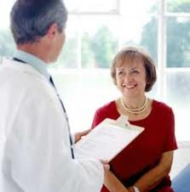
Gynaecology
General women’s problems
Infertility
Urogynaecolgy
cancer

Slide 5
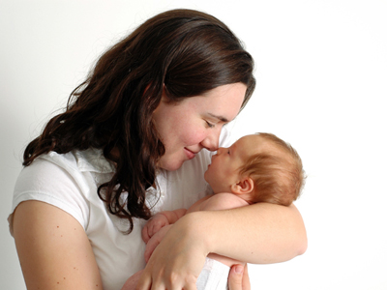
Why choose Obs & Gynae ?

Slide 6
What type of doctor ?
Team worker - multi-disciplined
Cope with extreme pressure
Deal with bad news
Like shift work
Opportunity for very high tech surgery or keep it very simple
Long hours if you like private practice
About 10 years of training after qualifying

